Slide 1
Thinking Clearly, Talking Fast Concept-Guided Non-Autoregressive Generation for Open-Domain Dialogue Systems
https://github.com/xinwei96/CoIndialogRE
EMNLP-2021
Reported by Dongdong Hu

Slide 2
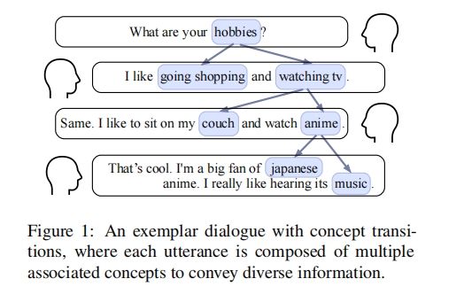
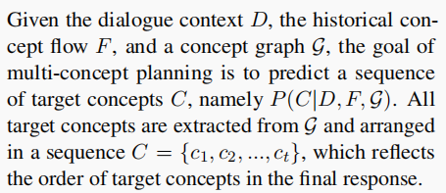
Introduction
Current dialogue models with the seq2seq framework lack the ability to effectively manage concept transitions
and can hardly introduce multiple concepts to responses in a sequential decoding manner.

Slide 3
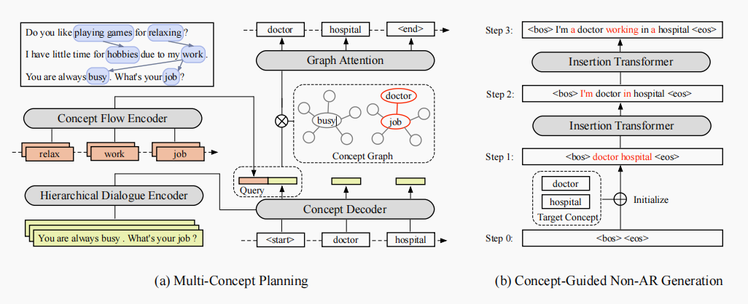
Method

Slide 4
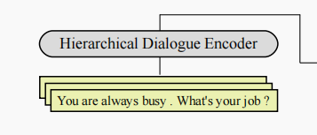
Method

Slide 5
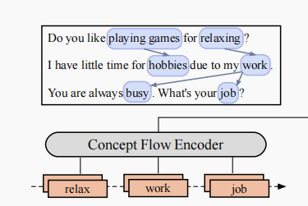
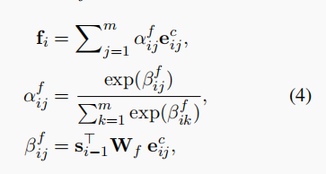
Method

Slide 6
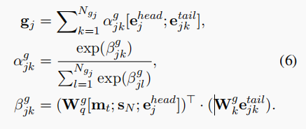
Method
Notes:
feed forward neural network layer (FFNN)
multi-class是相对于binary二分类来说的，意思是需要分类的东西不止有两个类别
multi-label是说一个sample的标签不知有一个。

Slide 7
Method
Notes:
feed forward neural network layer (FFNN)
multi-class是相对于binary二分类来说的，意思是需要分类的东西不止有两个类别
multi-label是说一个sample的标签不知有一个。

Slide 8
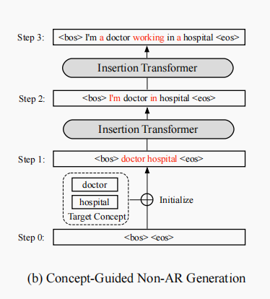
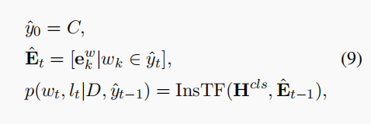
Method
Notes:
feed forward neural network layer (FFNN)
multi-class是相对于binary二分类来说的，意思是需要分类的东西不止有两个类别
multi-label是说一个sample的标签不知有一个。

Slide 9
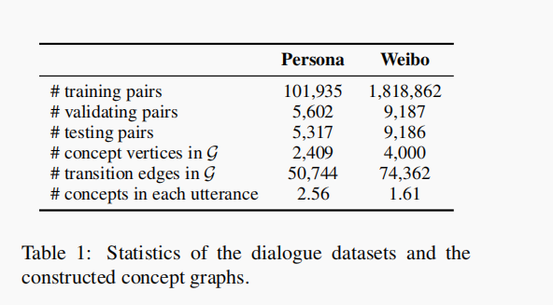
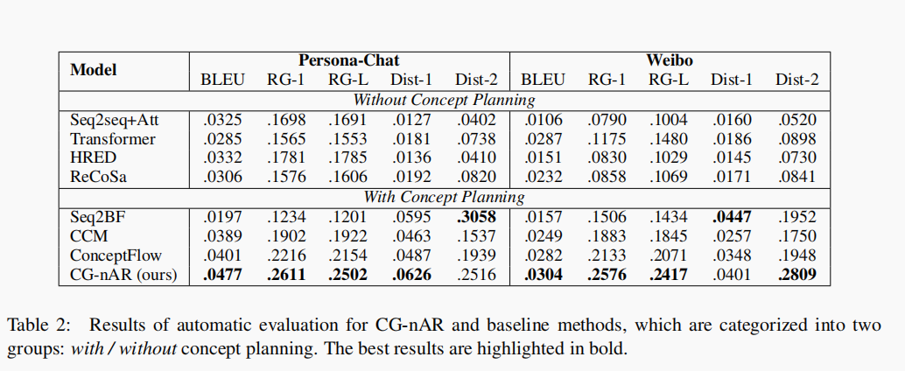
Experiments

Slide 10
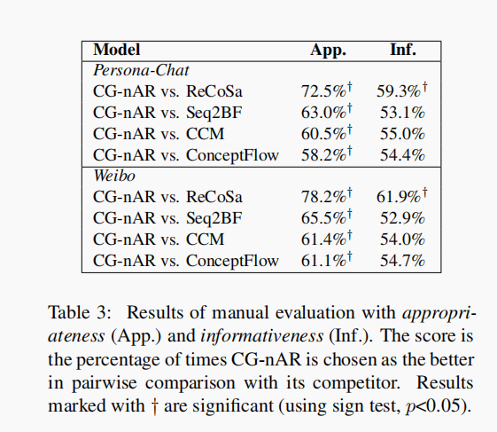
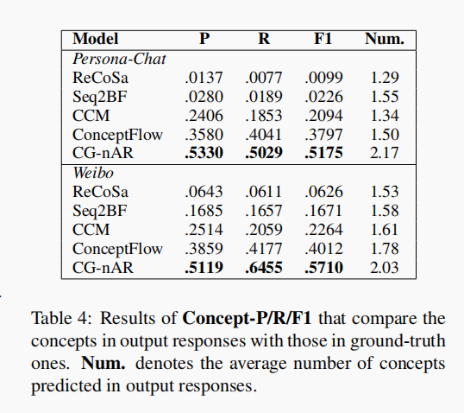
Experiments

Slide 11
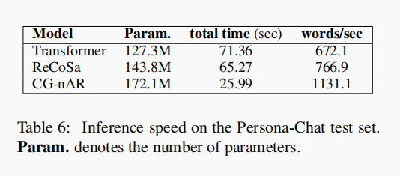
Experiments

Slide 12
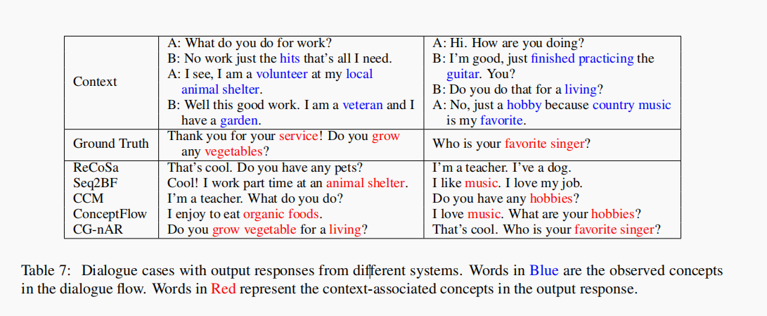
Experiments

Slide 13
Thanks

